Slide 1
Coronary angioplasty-GUIDEWIRES & CATHETERS
Dr Sreejith A G

Slide 2
COMPONENTS OF GUIDEWIRE
PROPERTIES OF AN IDEAL GUIDEWIRE
TYPES OF GUIDEWIRES

Slide 3
1982
John B Simpson et al reported the first experience with a new over-the- wire balloon system.
Could be passed beyond the coronary stenosis, providing a platform for the subsequent delivery of the balloon catheter.

Slide 4
COMPONENTS OF GUIDEWIRE
Central core composed of stainless steel or nitinol.
Distal tip – made of stainless steel /platinum/tungsten
Coating -Silicone, Polytetrafluroethylene (PTFE) or hydrophilic substances

Slide 5
Cross section of a guidewire

Slide 6
Central Core
Basic component of the guidewire.
Contributes to trackability,torquability and push transmission.
Support provided by the guidewire depends on strength of material constituting the central core and its thickness.
When the core extends to the tip, it is called a unibody guidewire.

Slide 7
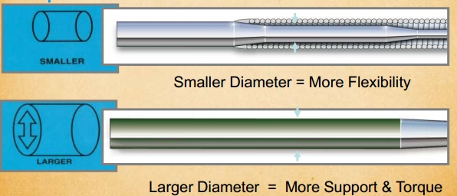
Core

Slide 8
Core material
Stainless steel
Strong
Flexible
Better torqueability
Greater tactile feedback
Nitinol
Elastic
No shape retention when bend
Less torqueability
Less tactile feedback

Slide 9
Tip style

Slide 10
Covers

Slide 11
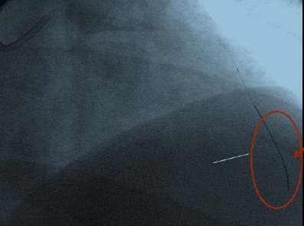
Radiopaque tip
Platinum coils placed at wire tip( distal 2 – 3 cm) provide visibilty(radio opaque).

Slide 12
PROPERTIES OF AN IDEAL GUIDEWIRE
Push transmission or steerability
Ability of a guidewire tip to be delivered to the desired position in a vessel.
Torque transmission
Ability to transmit rotational forces from operators hand to the tip of guidewire.
Increased core thickness increases torquability.

Slide 13
Trackability:Ability to advance interventional devices on the guidewire.
Flexibility:
Ability to bend with direct pressure.
Minimize vascular trauma.
Tip elasticity:
Shape memory retention of the distal tip throughout the entire procedure.

Slide 14
Tip visibility and markers:
Allows for visualization of distal tip in the vessel lumen.
Help in estimation of lesion length and choosing length of balloon catheters and stents.
Durability of the wire: kink resistance(wire can be used for multiple lesions)
Tactile feedback: feel of the wire tip

Slide 15
Prolapse tendency:
Tendency of the guidewire tip to kink once passed into a vessel.
Common with floppy tip guidewires
Problem when lesions are very tight or lesions are in angulated vessels.
After crossing the lesion, beneficial –reduces the possibility of guide wire trauma to distal vessel

Slide 16
TYPES OF GUIDEWIRES
Depending on the tip load the guidewires can be classified as balanced, extra support or floppy.
Tip load is defined as the force needed to bend a wire when exerted on a straight guide wire tip, at 1 cm from the tip.
As tip load increases, the wire becomes stiffer
provides more support
more prone to perforation.

Slide 17
Tip load

Slide 18
Balanced guidewires
Tip load range between 0.5 and 0.9 g.
Balance between flexibility, support and steerability.
Constitute the bulk of use in any cath. lab -also called frontline guidewires or workhorse guidewires

Slide 19
Extra-support guidewires
Extra-support guidewires are designed for cases where additional support is needed for device delivery.
Include intravascular tortuosity, calcification, noncompliance, previously deployed stents or when bulky devices are used.
The tip load is more than 0.9g.

Slide 20
Floppy wires
Soft guidewires are useful in negotiating a tortuous anatomy
May lack body support for device tracking
Once lesion is crossed, soft guidewire may be exchanged with a extra support guidewire.
Extra support guidewires provide enhanced tracking of balloons and stents.

Slide 21
Diameter: 0.36mm(0.014 inch)
Spring coil length:11cm
Guide wire length:180/300cm
Tip: Straight/J

Slide 22
Diameter:0.23mm(0.009 inch)/0.36mm(0.014 inch)
Spring coil length:11cm
Guide wire length:190/300cm
Tip: Straight

Slide 23
Diameter: 0.36mm(0.014 inch)
Spring coil length:4cm
Guide wire length:180/300cm
Tip: Straight/J

Slide 24
WHISPER Guide Wire
Tip load:0.8/1/1.2 gm
Diameter: 0.36mm(0.014 inch)
Radiopaque length : 3cm
Guide wire length:190/300cm
Tip: Straight

Slide 25
Asahi SION blue
Tip load: 0.5g
Diameter: 0.36mm(0.014 inch)
Spring coil length:20cm
Guide wire length:180/300cm
Tip: Straight/J

Slide 26
Runthrough NS
Dual Core –
Main shaft core of SS & Distal core – Nitinol.
Tip-nitinol shaping ribbon

Slide 27
Tip load:3/4.5/6/12gm
Diameter: 0.36mm(0.014 inch)
Spring coil length:11cm
Guide wire length:180cm
Tip: Straight

Slide 28
Diameter: 0.23(0.009)/0.36mm(0.014 inch)
Spring coil length:20cm
Guide wire length:180cm
Tip: Straight

Slide 29
CROSS IT SERIES (100/200/300/400 XT)
Tip load:1.7/4.7/6.2/8.7gm
Diameter: 0.36mm(0.014 inch)
Radiopaque length : 3cm
Guide wire length:190/300cm
Tip: Straight/J

Slide 30
summary
Central core of guidewires are composed of stainless steel or nitinol
Based on the tip load the guidewires can be classified as balanced, extra support or floppy.
Balanced guidewires are called “workhorse guidewires”
Extra-support guidewires are designed for cases where additional support is needed for device delivery
Heavy-duty guidewires are not suited as primary guidewires because of their stiffness and poor torque control

Slide 31
GUIDING CATHETERS

Slide 32
Functions of a Guide Catheter
Support for device advancement
Conduit for device and wire transport
Vehicle for contrast injection
Measurement of Pressure
Different makes, shapes, sizes & uses
Notes:
32

Slide 33
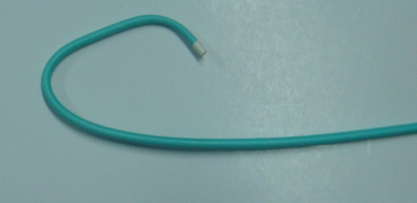
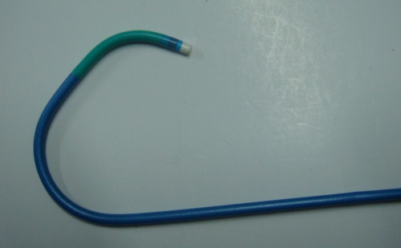
Diagnostic vs Guide catheters
Stiffer shaft
Larger internal diameter (ID)
Shorter & more angulated tip (110º vs. 90º), non tapering tip
Re-enforced construction (3 vs. 2 layers).
Notes:
33

Slide 34
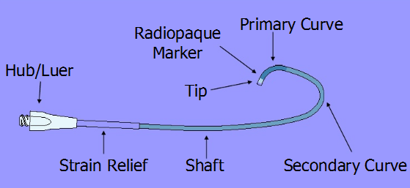
Parts of a Catheter
Usual length= 100 cm
Tertiary curve in some catheters

Slide 35
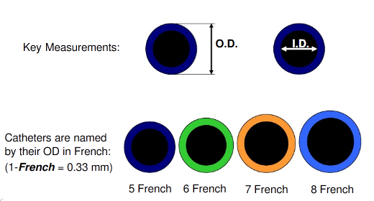
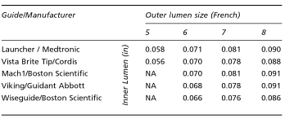
Catheter size
Catheter size in French
For each given size - ID is
either standard, large

Slide 36
Cross section of catheter
Strength
Support/Flexibility
Kink resistance
Polyurethane or Polyethylene
1:1 Torque
Kink resistance
Stainless steel/ Kevlar
Internal lumen
Smooth or lubricious material
Device compatibility
PTFE (Polytetrafluoroethylene) like Teflon

Slide 37
Important features of a guide catheter
Preformed curves & configurations, optimum support
Adequate lumen & device compatibility
Easy to handle, torque control, kink resistance
Atraumatic tip

Slide 38
Side hole vs no side hole
Side holes are useful where the pressure gets frequently damped as in RCA interventions, CTO interventions or sole surviving artery or left main interventions
Advantages
Prevent catheter damping (occlusion of the coronary ostium)
Allow additional blood flow out of tip, to perfuse the artery.
Avoid catastrophic dissections in the ostium of the artery
Disadvantages
False sense of security because now, aortic pressure, and not the coronary pressure is being monitored.
Suboptimal opacification
Reduction in back up support provided because of weakness of catheter shaft and the kinking at side holes
Notes:
contrast escapes through side holes
38

Slide 39
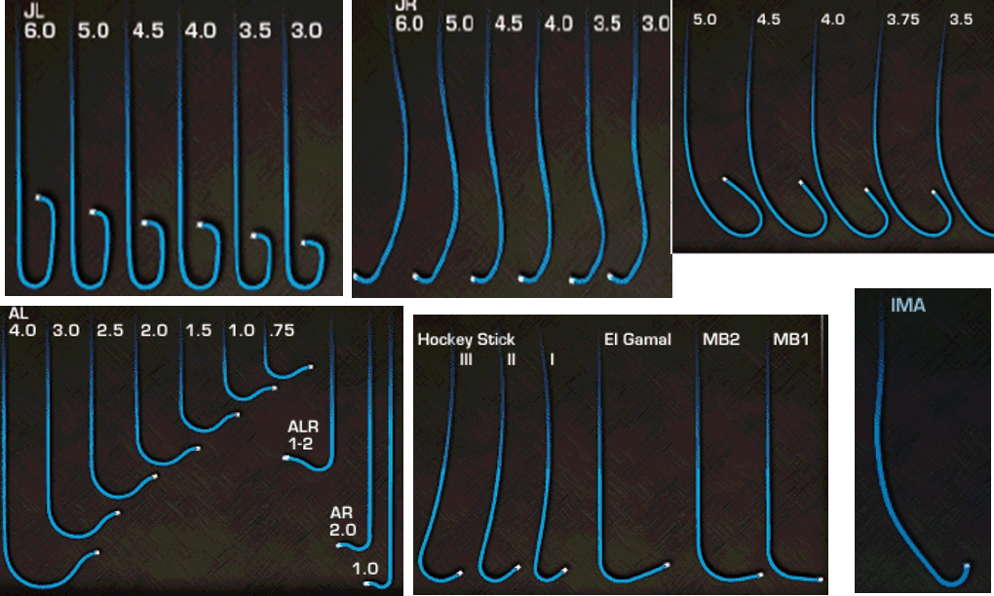
Most commonly used guides
Judkins, Amplatz, and Extra-back-up guides
Others include - Multipurpose for RCA bypass or a high left main (LM) takeoff
LIMA catheter for - right and left coronary bypass graft
Notes:
that have a niche in various situations
39

Slide 40
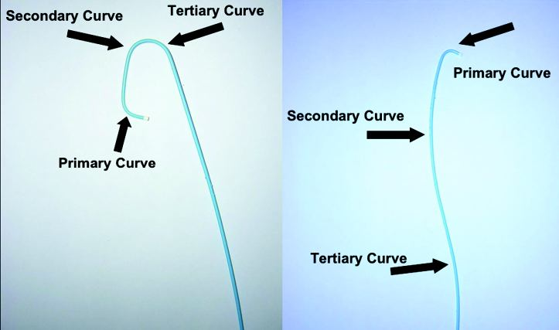
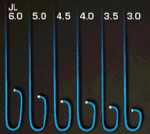
The Judkins Guide
Primary (90º), secondary (180º), and tertiary (35º) curves fit aortic root anatomy
As 1⁰ curve fixed Intubates small
segment of ostium - ↓risk of trauma
Engage the LM ostium without much manipulation

Slide 41
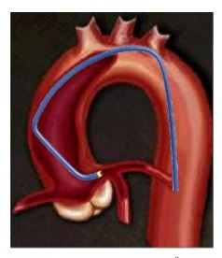
JUDKINS GUIDE
Selected according to
width of the ascending aorta
location of the ostia to be cannulated
orientation of the coronary artery
segment proximal to the target lesion
Segment between the primary and secondary curve of the Judkins left guide should fit width of ascending aorta
ex:3.5 cm,4 cm, 4.5 cm

Slide 42
Locations of the ostia:- can be low, high or more anteriorly or posteriorly oriented
For Asian patients, a 3.5 cm Judkins left guide usually fits well
Superior direction of the LM or narrow aortic root - smaller size guide
Horizontal or wide aortic root - JL with long secondary curve (size 5 or 6)

Slide 43
Limitations of Judkins Guide
As 1⁰ curve is fixed - may not be co-axial with the artery
may be difficult to pass balloons - as catheter makes an angle of 90º with ostium
JL- point of contact on ascending aorta - very high & narrow- ↑ chance of prolapse & dislodgement
JR- no point of contact on asc Aorta - extremely poor support

Slide 44
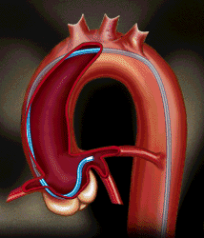
The Amplatz Guide
Secondary curve rest against the noncoronary posterior aortic cusp
Offers firm platform for advancement of device
Best in the case of a short LM, with downgoing left circumfl ex artery (LCX)
Tip points slightly downward - higher danger of ostial injury causing dissection

Slide 45
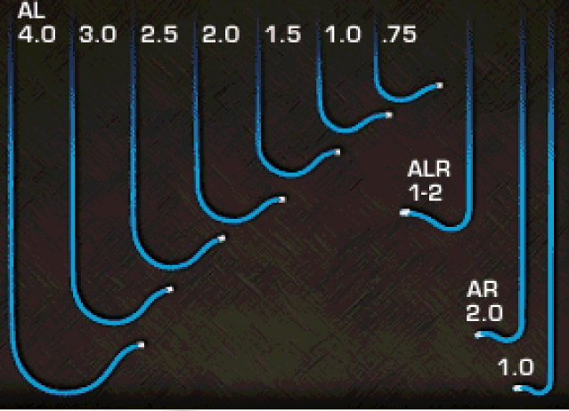
Amplatz Guide
Selection of the proper size for an Amplatz guide is essential
Size 1 is for the smallest aortic root
size 2 for normal
size 3 for large roots
Attempts to force engagement of Amplatz guide- increase risk of complication

Slide 46
Amplatz Guide
If tip does not reach the ostium and keep lying below it - guide is too small
If tip lies above the ostium - guide is too large
When RCA ostium is very high - left Amplatz guide may be used to engage the right ostium
Notes:
Optimal Position
Once the tip of the Amplatz is inside an LM or RCA ostium, the primary and secondary curves should form a closed loop
With the tip coaxial to the ostial segment
46

Slide 47
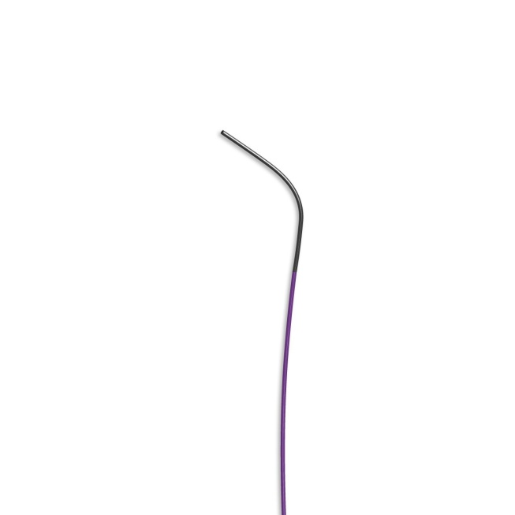
Multipurpose Guide
Straight with a single minor bend at the tip
For RCA bypass graft or a high left main (LM) takeoff

Slide 49
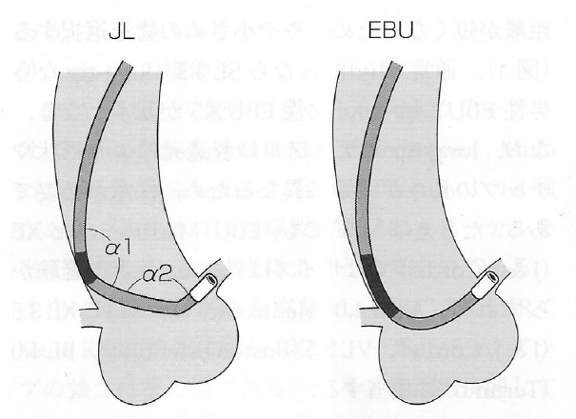
Long tip catheters
XB, EBU
Advantages
coaxial intubation
better support and stability
lack of bends -improve advancement of devices,decrease the loss of supportive forces
safety
Notes:
BL
49

Slide 50
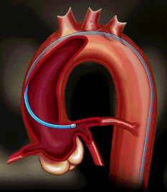
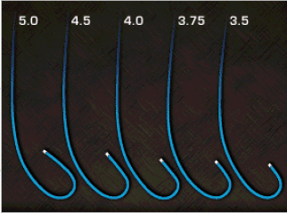
Extra-Back-Up Guide
Long tip forms a fairly straight line with the LM axis or the proximal ostial RCA
Long secondary curve - abut the opposite aortic wall
So tip in the coronary artery is not easily displaced
Provide a very stable platform
Notes:
50

Slide 51
Other catheters
Arani
Double angle 90 º curve sits on ascending aorta in S configuration and is therefore useful for RCA with horizontal take-off & shephered crook RCA
Primary and secondary curve provides two contact points on the opposite side of aorta thus
providing tremendous back-up support

Slide 52
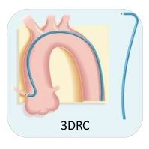
3 DRC - Three dimensional right curve - for tortuous, bent anatomy and posterior or superior take off of RCA

Slide 54
Curve selection factors
Aortic Width
Coronary Anatomy
French Size
Active vs. Passive Support
Native Coronary vs. CABG
Amount of Calcium in Target Vessel

Slide 55
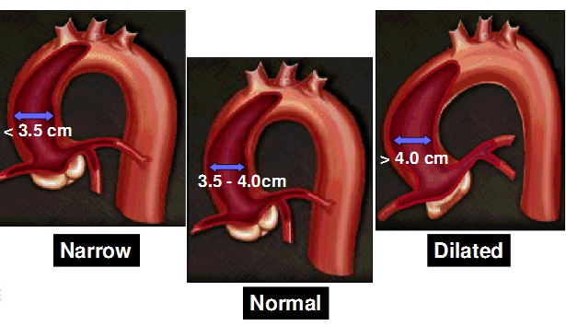
Aortic width
www.medtronic.com
Notes:
Depending on catheter size selective hooking
55

Slide 56
French Size Influence
Historically, 8F guides were necessary to deliver devices because of their larger internal lumens.
Current 6-7F catheters have internal lumens just as large as previous generation 8F catheters.
Large guides require side-holes more frequently to improve perfusion

Slide 57
Back-Up Support
Ability of the guiding catheter to remain in position and provide a stable platform for the advancement of interventional equipment
There are 3 main types of back up support
Passive
Active
Balanced

Slide 58
Passive support
Strong support given by
inherent design of a guide with good back-up against opposite aortic wall
stiffness from manufactured material
Additional manipulation is generally not required
Mainly passive
Amplatz

Slide 59
Active support
Active support is typically achieved by
Manipulation of the guide - into a configuration conforming the aortic root
Deep-Seating – Intubation with deep engagement of the guide into the coronary vessels
Balanced Support
Rely on the inherent property of shaft and shape for coaxiallity, but can be manipulated in cases requiring extra support
Judkins
EBU

Slide 60
Coronary Anatomy Ostial Variations
Coronary ostial
location:
high
low
anterior
posterior
Coronary ostial orientation:
superior
horizontal
inferior
shepherd’s crook (RCA’s only)

Slide 61
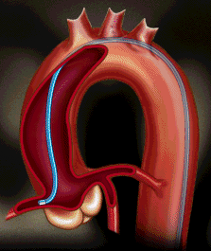
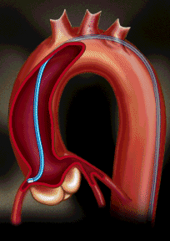
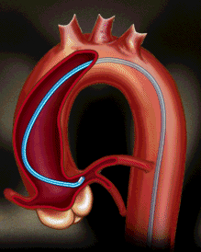
Coronary Ostial Takeoffs
Horizontal
Inferior
Superior

Slide 62
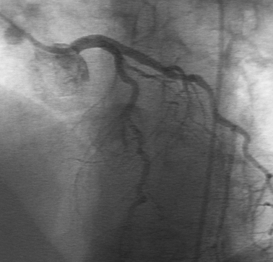
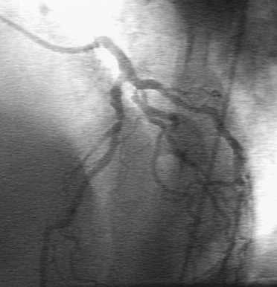
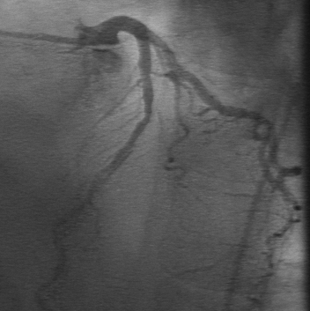
Common Takeoffs- Left Coronary Artery
Horizontal
Inferior
Superior

Slide 63
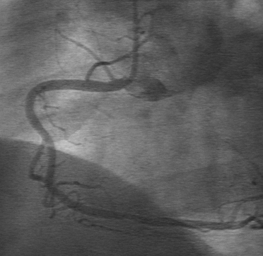
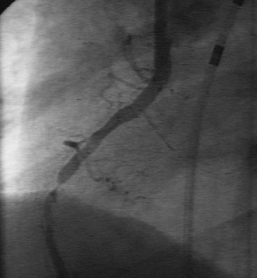
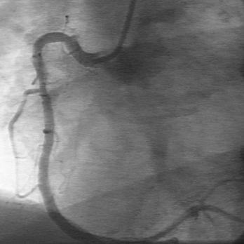
Common Takeoffs Right Coronary Artery
Horizontal
Inferior
Superior

Slide 64
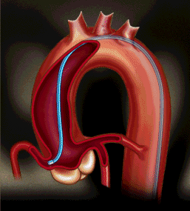
Coronary Ostial Takeoffs Shepherd’s Crook (RCA only)
RCA origin is not only superiorly oriented but also courses superiorly to some extent before making a U-turn.

Slide 65
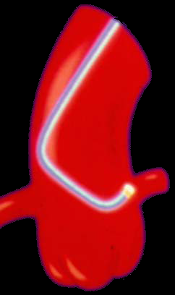
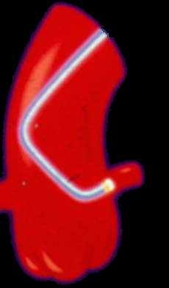
Guide Catheter Selection
* MOST IMPORTANT REQUIREMENT: CO-AXIAL ALIGNMENT
Non-Coaxial
Coaxial

Slide 66
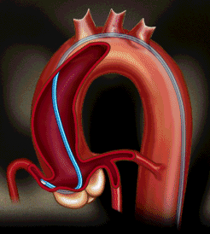
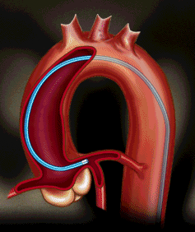
Guiding Catheter Support
JR4
Hockey Stick
EBU
Coaxial alignment, with extra support from Sinus of Valsalva
Coaxial alignment, with power support from opposite wall of aorta
Simple coaxial alignment,
without support

Slide 67
Short and long LMCA
If the LM is short and there is no acute angle at the bifurcation with the LCX - left Judkins
If the LM is long and the angle between the LM and LCX is acute - extra-backup guide
(Tip of the guide is very close to the ostium of the LCX so the acuity of the LM and LCX angle is nullified)

Slide 68
High Left Takeoff- LCA
AL 1.5
EBU 3.5

Slide 69
RCA interventions
Usual - JR or Hockey stick guide
If extra support – CTO, tortuosity – AL1
Abnormal take off of RCA from aorta esp inf orientations - MP guide
Tortuous or bent anatomy, posterior and superior take off of RCA - 3DRC

Slide 70
Shepherd’s crook deformity of RCA
Dramatic upturn with a near 180 degree switch back turn
www.medtronic.com
Notes:
Guides with the tip pointing in cranial direction are necessary
Amplatz left guide
hockey stick
left venous bypass
internal mammary artery guides
70

Slide 71
GUIDES FOR CORONARY ANOMALIES
Important to be aware of variations of coronary anomalies
Systematically search in other aortic sinuses when the vessel in question does not arise
Anomalous artery from the right sinus -
Left, right Amplatz ,Multipurpose
Anomalous artery from the left sinus
Larger left Judkins ,Left Amplatz ,Multipurpose

Slide 72
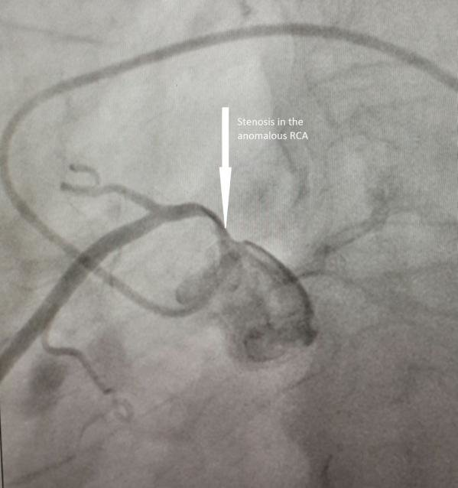
Guides for Anomalous Coronary Arteries Arising from the Left Sinus
When RCA arises from the left cusp usually it is anterior and cephalad to LM
JL with secondary curve one size larger than one used for the patient’s LM
Pushed deep in the left sinus , causing it to make an anterior and cephalad U-turn
Larger curve will prevent guide to engage LM

Slide 73
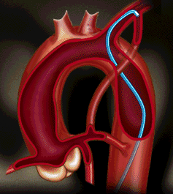
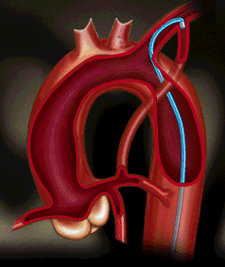
SVG and LIMA
Usual – JR
Abnormal positions and take offs MP or AL1
LCB/RCB
Internal mammary artery - IMA catheter , LCB
IMA Catheter is designed for both Rt. And left Internal Mammary arteries
shaped like a JR catheter but with a steeply angled tip (80 to 85º).
LCB
IMA

Slide 74
Choice of Catheters for Interventions via Radial Artery

Slide 76
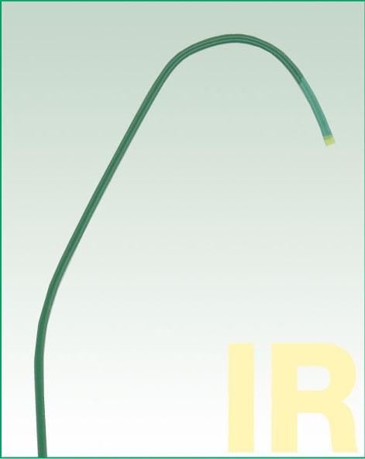
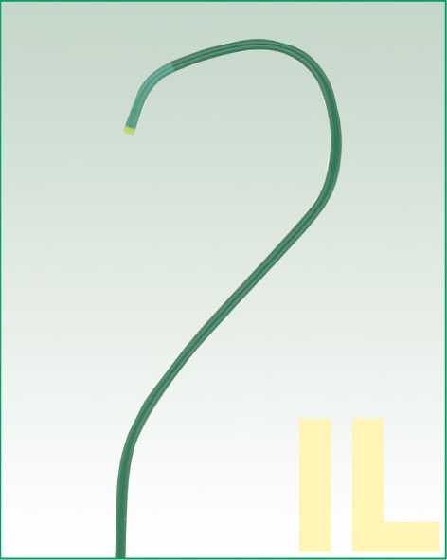
Ikari catheter – for trans radial intervention
Ikari L can generate greater backup force than JL in TRI
Ikari R (IR) 1.5 Ikari L (IL) 4

Slide 77
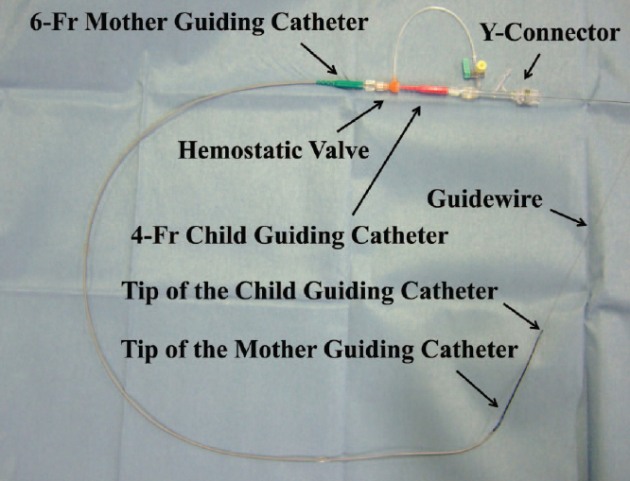
Mother and child
Improve the delivery of coronary stents to complex lesions
Child catheters 4/5 F 120 cm
Mother catheter - 6 F guiding catheter 100cm
Superior trackability of the 4F child catheter
Increased backup support of the mother-child system
4F mother-child system provided > 90% success rate
(Circ Cardiovasc Interv. 2011;4:155-161.)

Slide 78
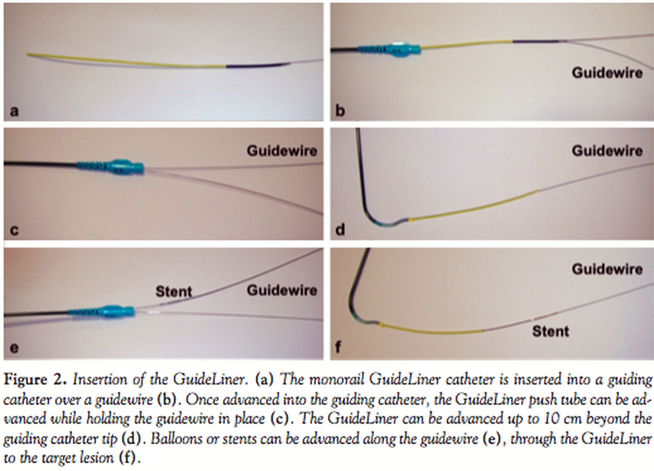
Guideliner catheter
GuideLiner catheter is a coaxial guiding catheter extension delivered through a standard guiding catheter on a monorail
Permits very deep intubation of the target vessel, thus providing backup support to facilitate stent delivery across heavily calcified lesions in tortuous vessels

Slide 80
THANK YOU
Notes:
The following statements regarding the Judkins Left (JL) and Judkins Right (JR) coronary catheters in a normal aorta are true or false? When the guide tip has an inferior orientation below the ostium, the curve is too large. When the guide tip has a superior orientation above the ostium, the guide is too small. a) True b) False
80

